Slide 1














하계인턴
7주차
LPI 레이더
정석현

Slide 2
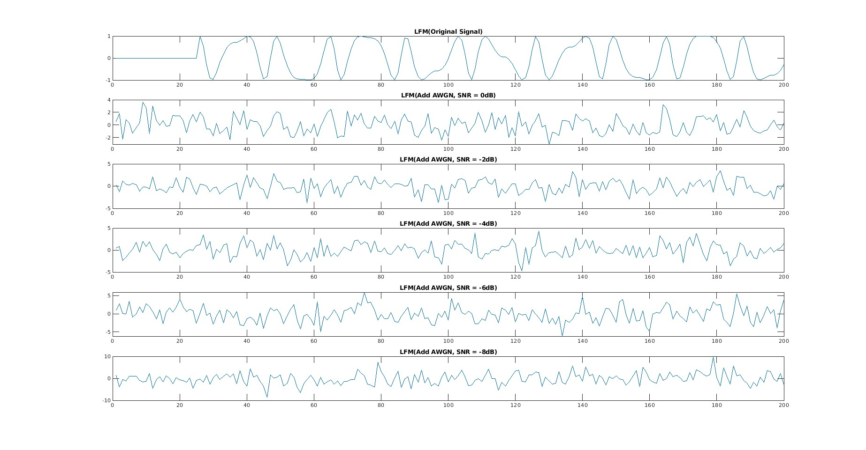
하계인턴7주차
01.
LFM : Sampling Rate / Sampling Frequency = 20

Slide 3
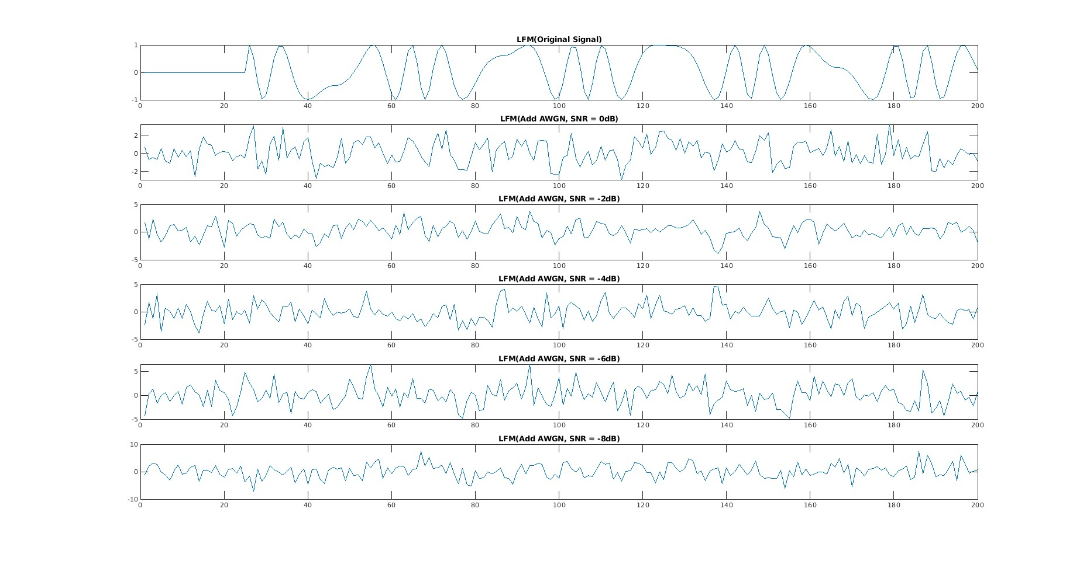
하계인턴7주차
02.
LFM : Sampling Rate / Sampling Frequency = 40

Slide 4
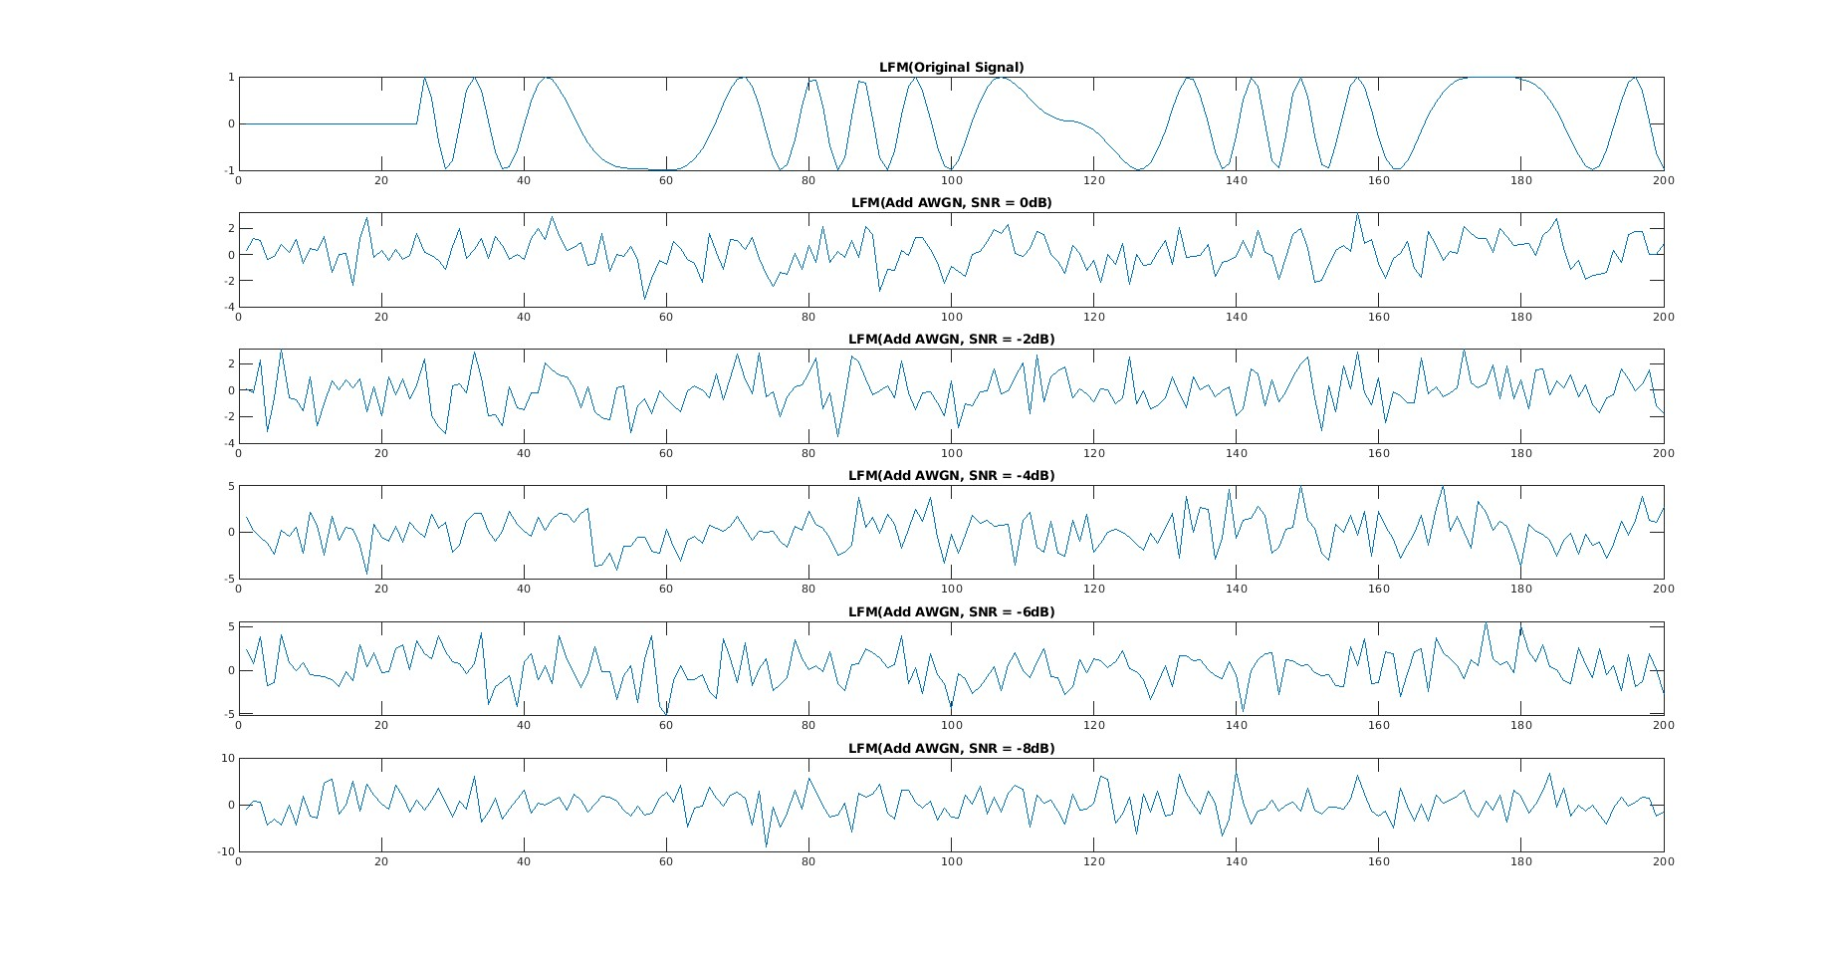
하계인턴7주차
03.
LFM : Sampling Rate / Sampling Frequency = 60

Slide 5
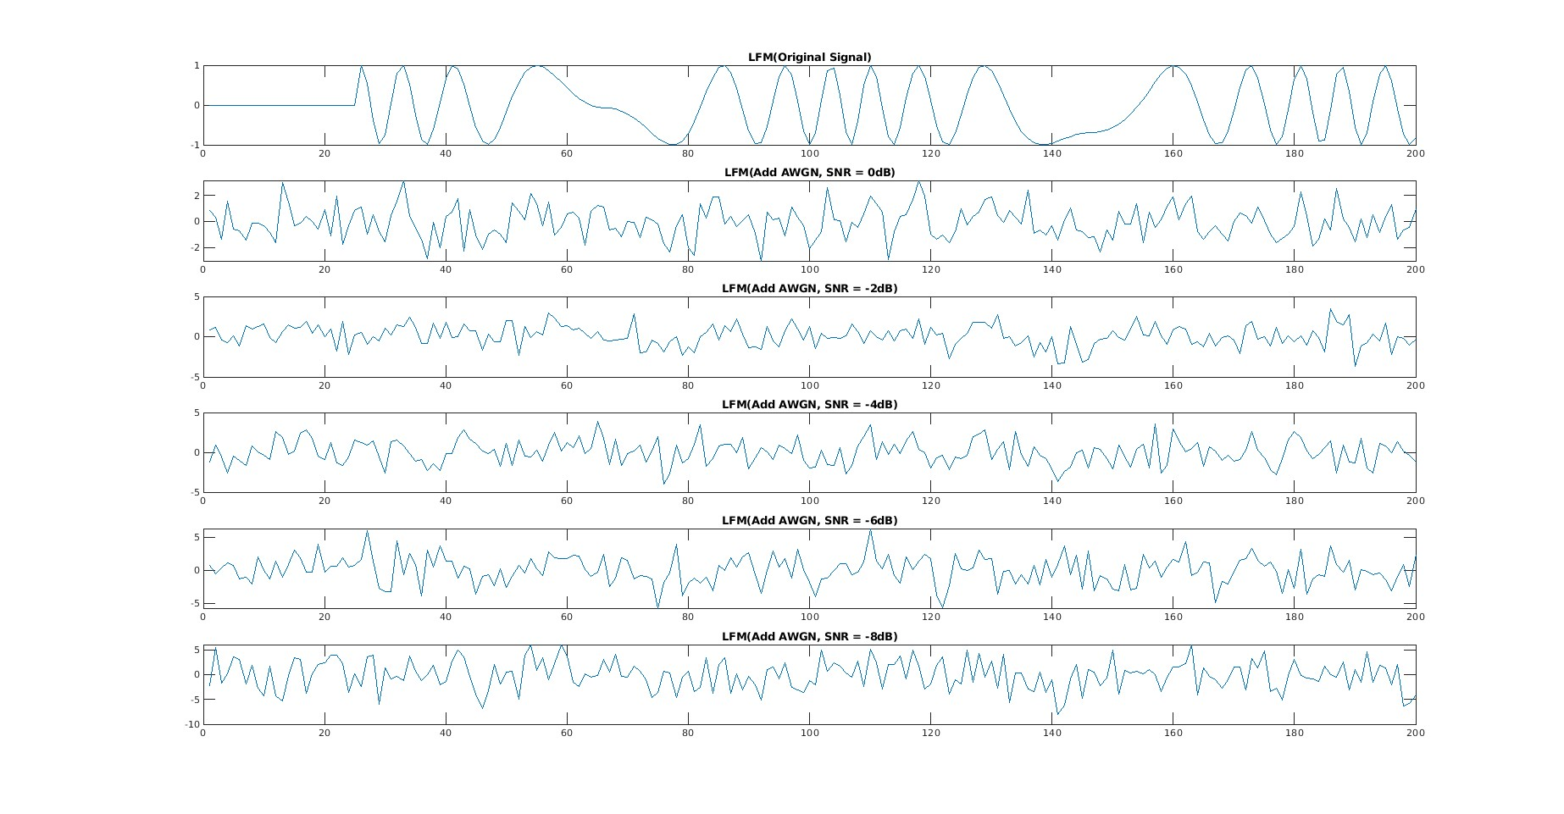
하계인턴7주차
04.
LFM : Sampling Rate / Sampling Frequency = 80

Slide 6
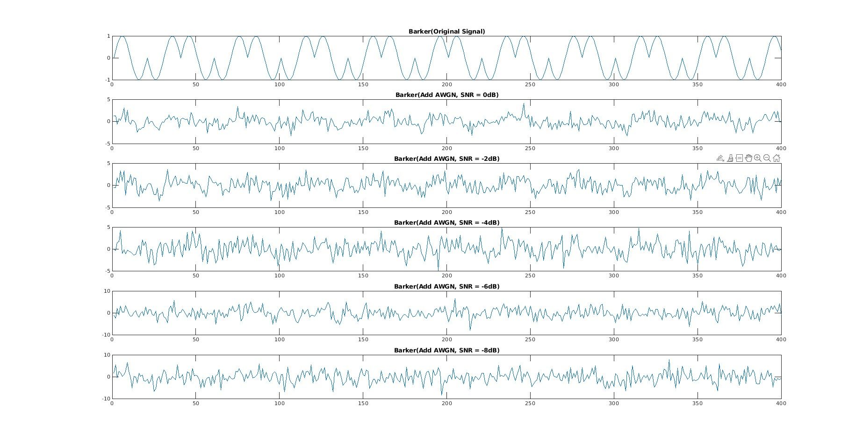
하계인턴7주차
05.
Barker : Length of code = 2

Slide 7
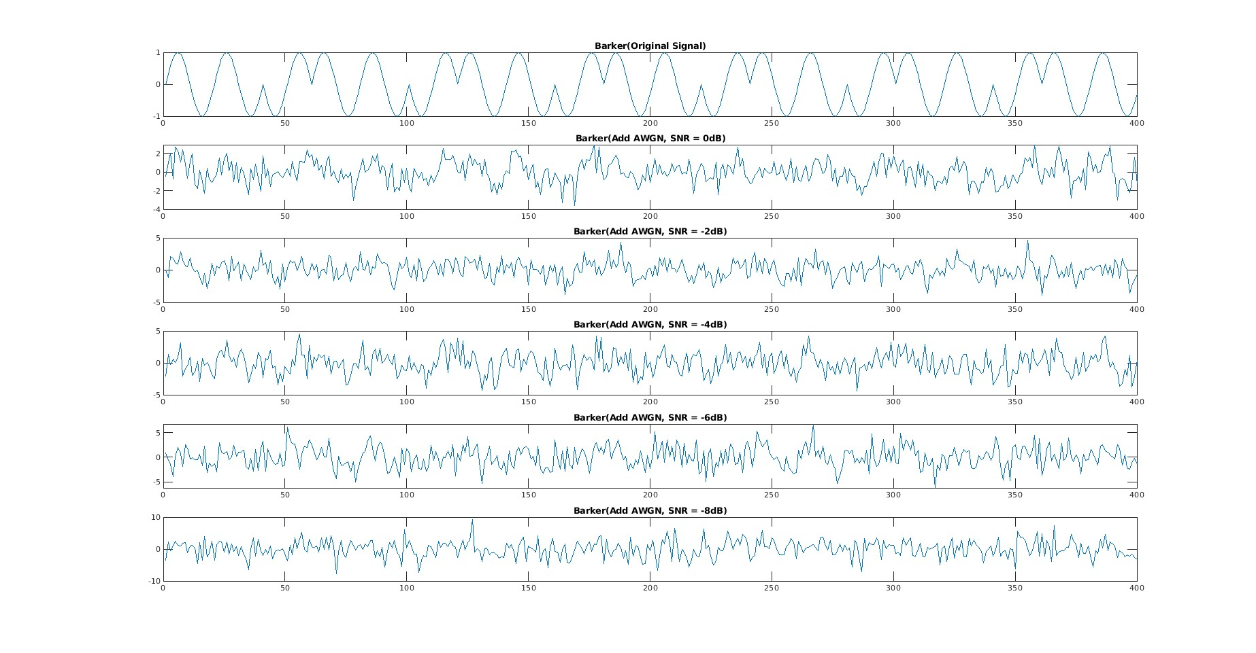
하계인턴7주차
06.
Barker : Length of code = 3

Slide 8
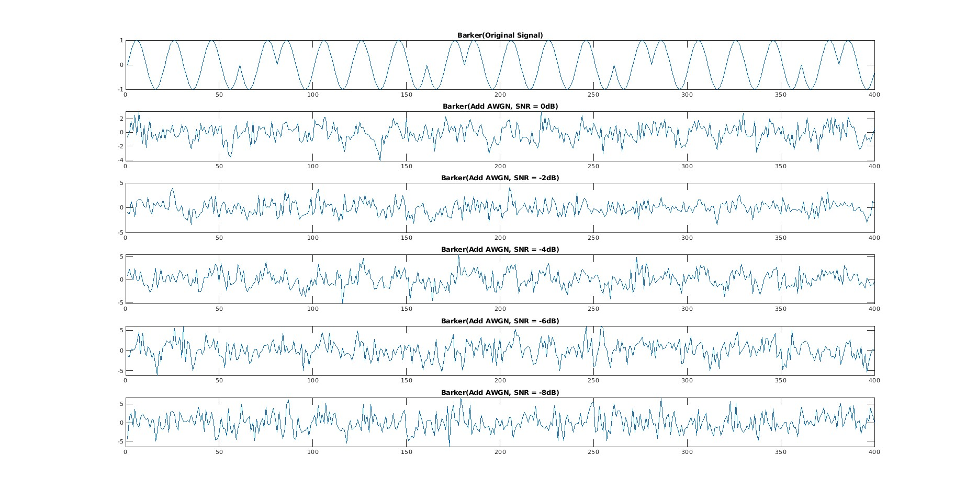
하계인턴7주차
07.
Barker : Length of code = 5

Slide 9
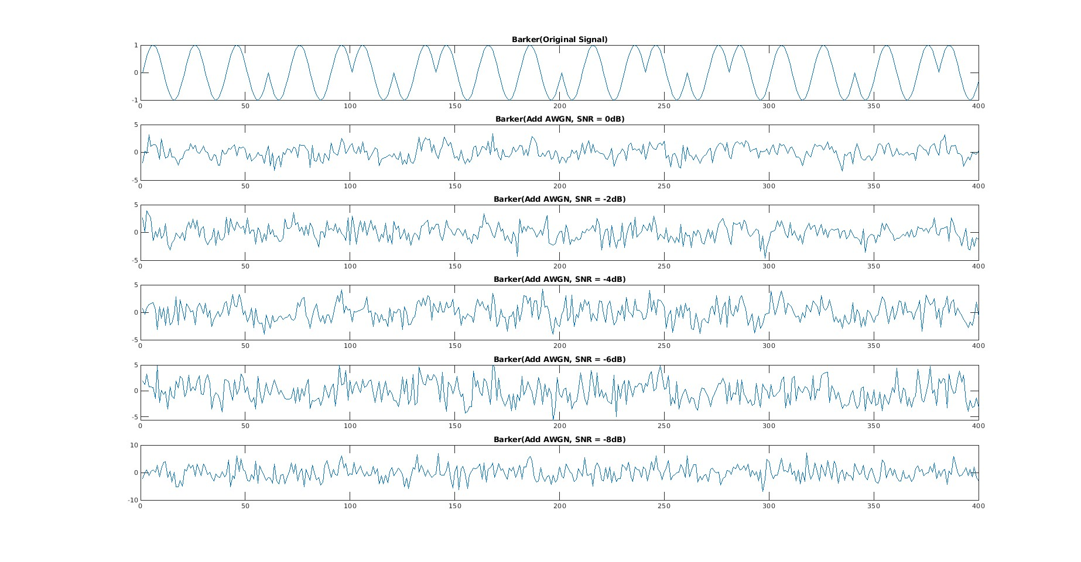
하계인턴7주차
08.
Barker : Length of code = 7

Slide 10
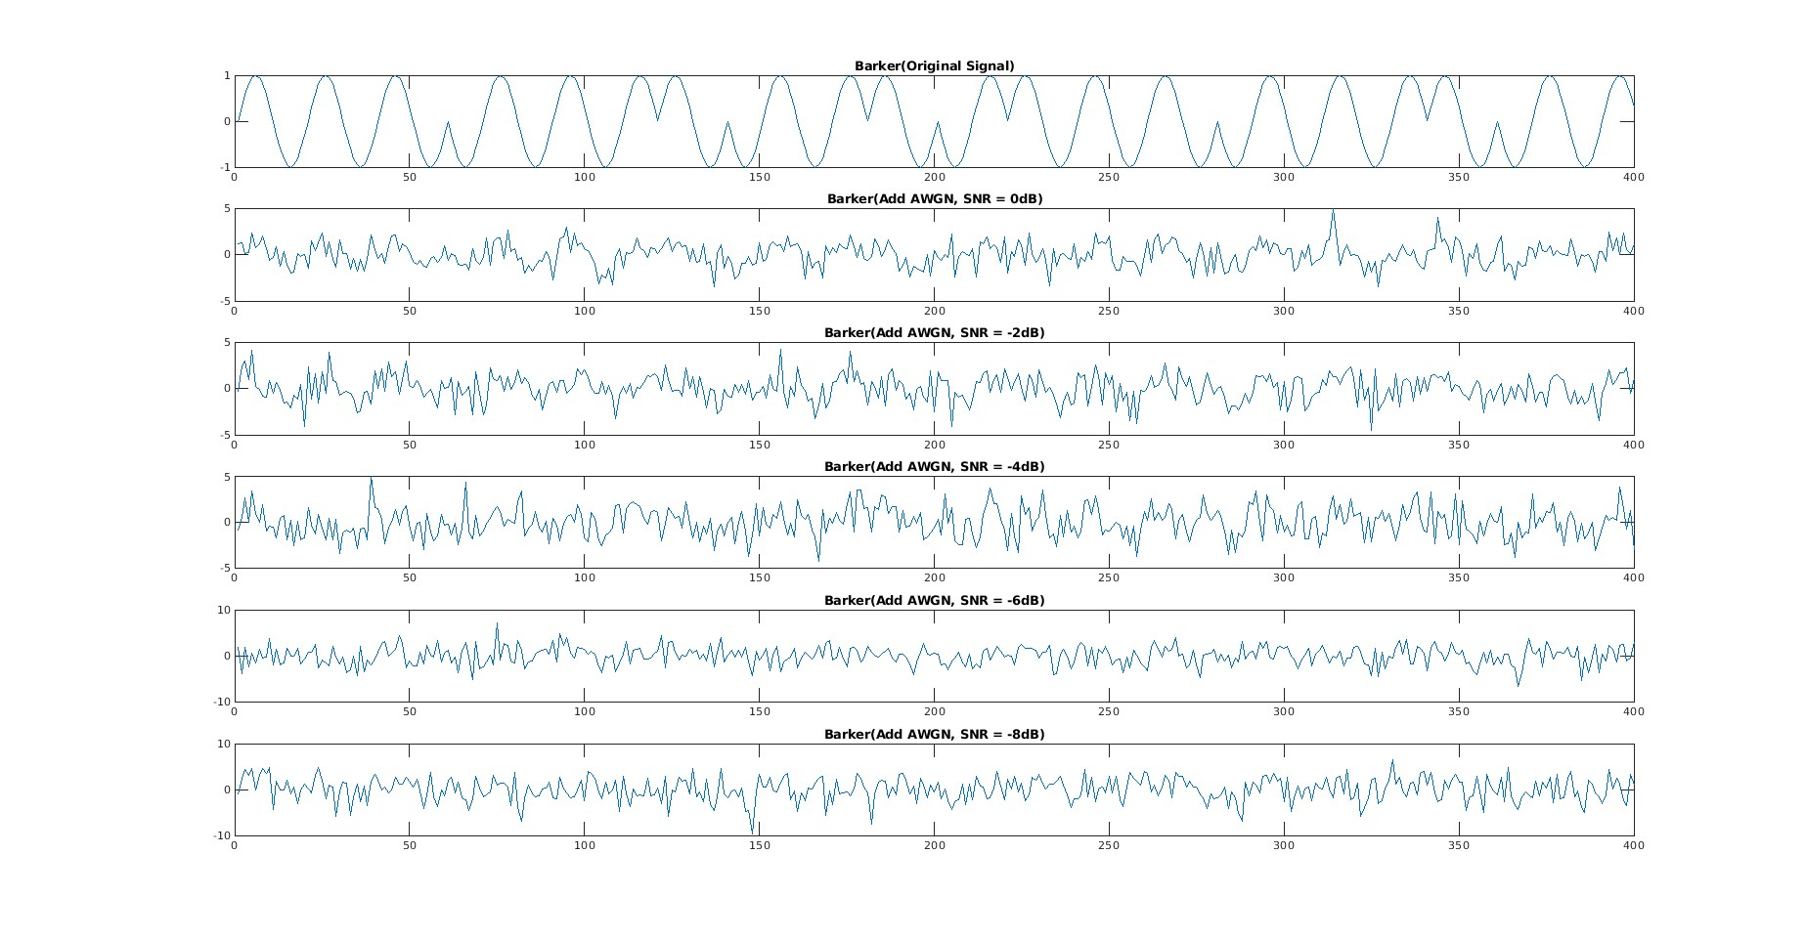
하계인턴7주차
09.
Barker : Length of code = 11

Slide 11
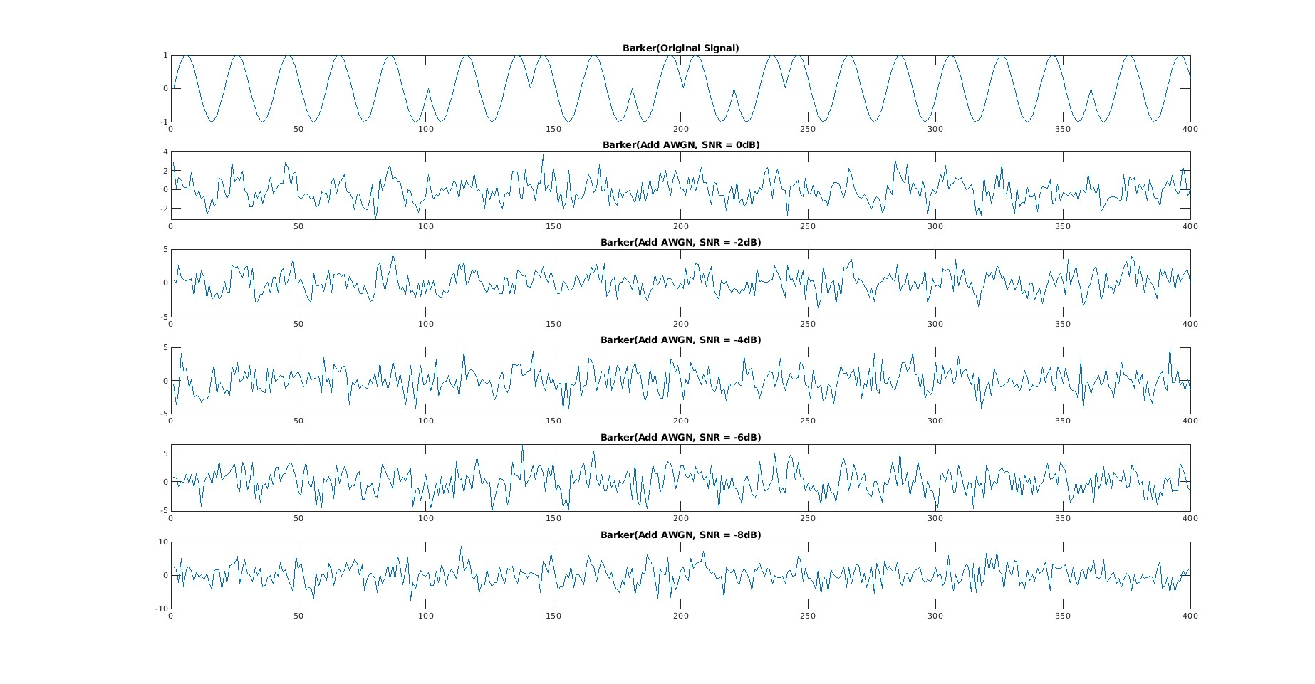
하계인턴7주차
10.
Barker : Length of code = 13

Slide 12
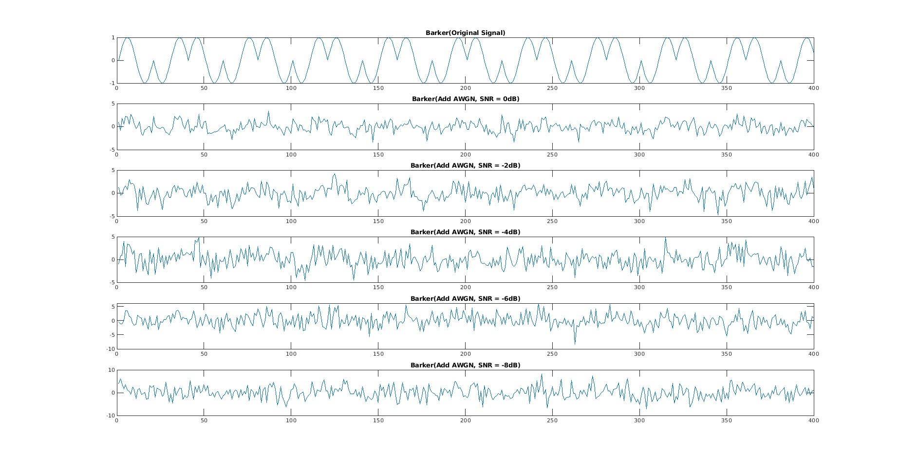
하계인턴7주차
11.
Barker : Sampling Rate / Sampling Frequency = 20

Slide 13
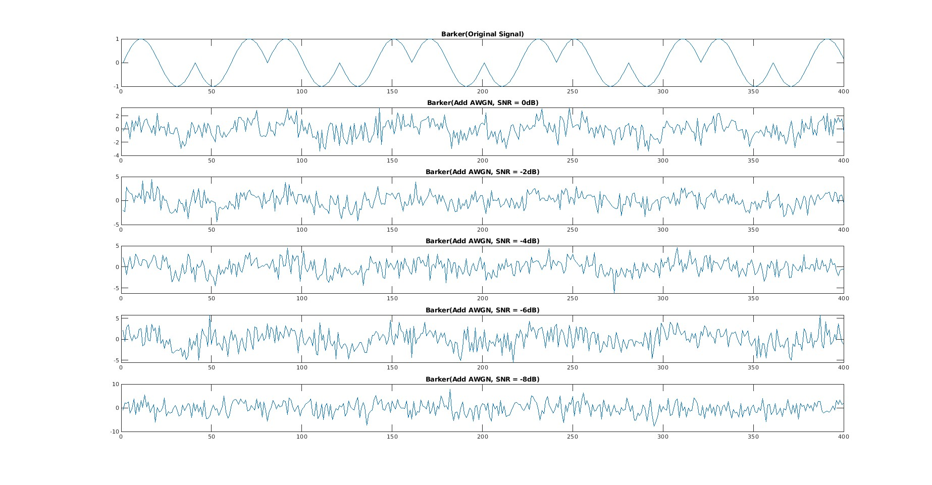
하계인턴7주차
12.
Barker : Sampling Rate / Sampling Frequency = 40

Slide 14
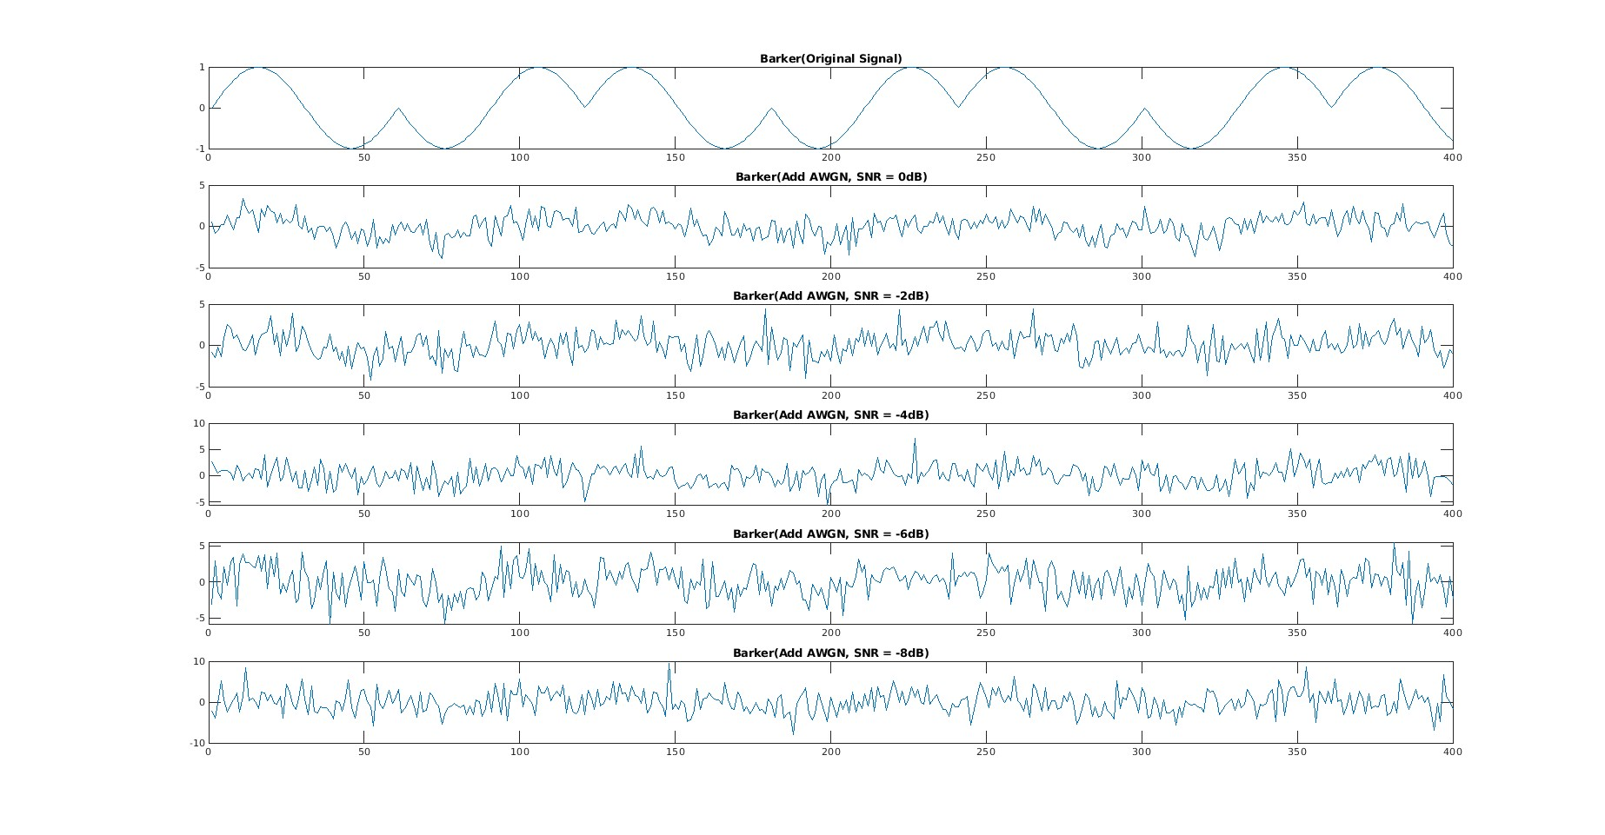
하계인턴7주차
13.
Barker : Sampling Rate / Sampling Frequency = 60

Slide 15
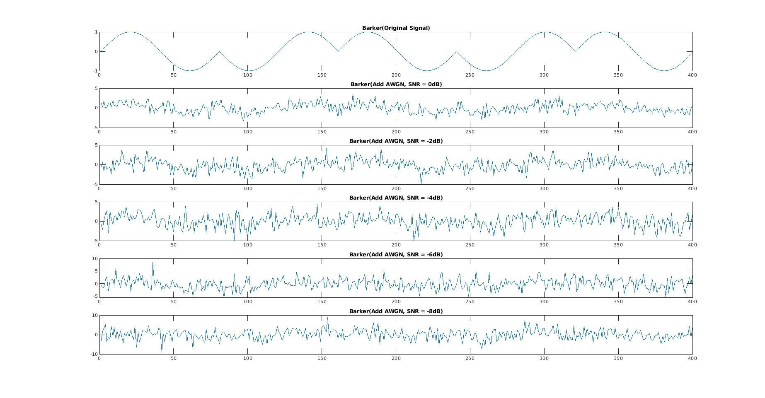
하계인턴7주차
14.
Barker : Sampling Rate / Sampling Frequency = 80

Slide 16
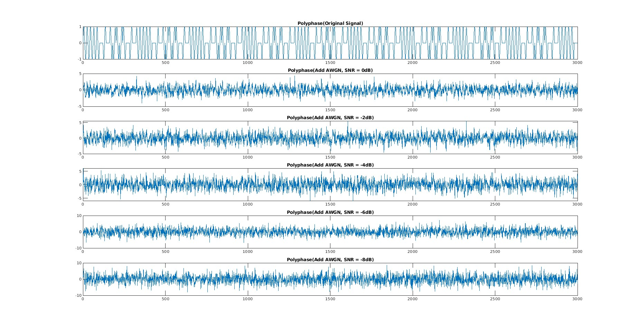
하계인턴7주차
15.
Polyphase : Sampling Rate / Sampling Frequency = 20

Slide 17
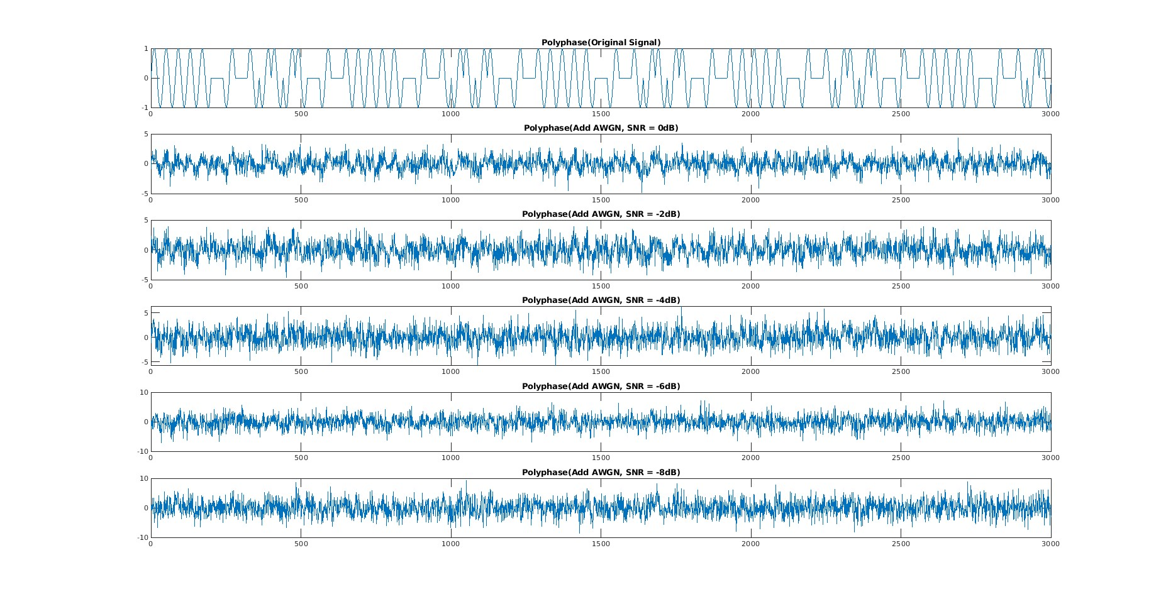
하계인턴7주차
16.
Polyphase : Sampling Rate / Sampling Frequency = 40

Slide 18
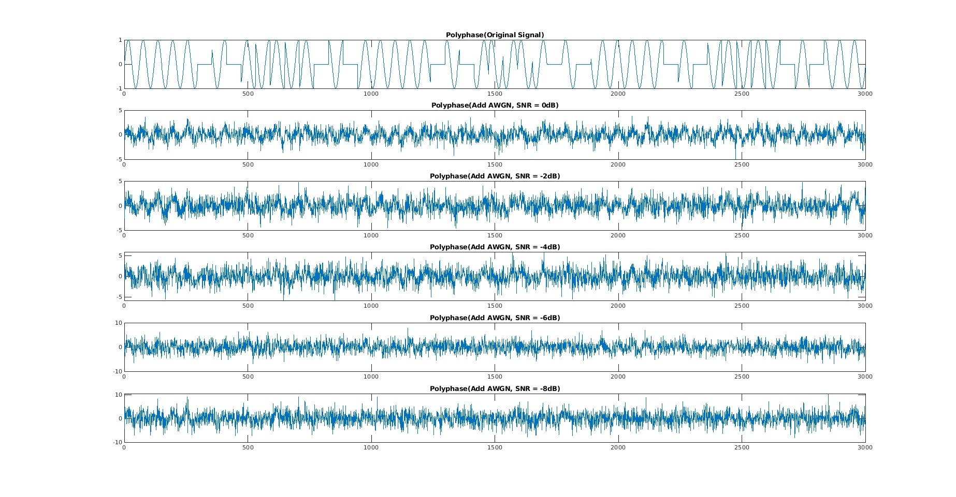
하계인턴7주차
17.
Polyphase : Sampling Rate / Sampling Frequency = 60

Slide 19
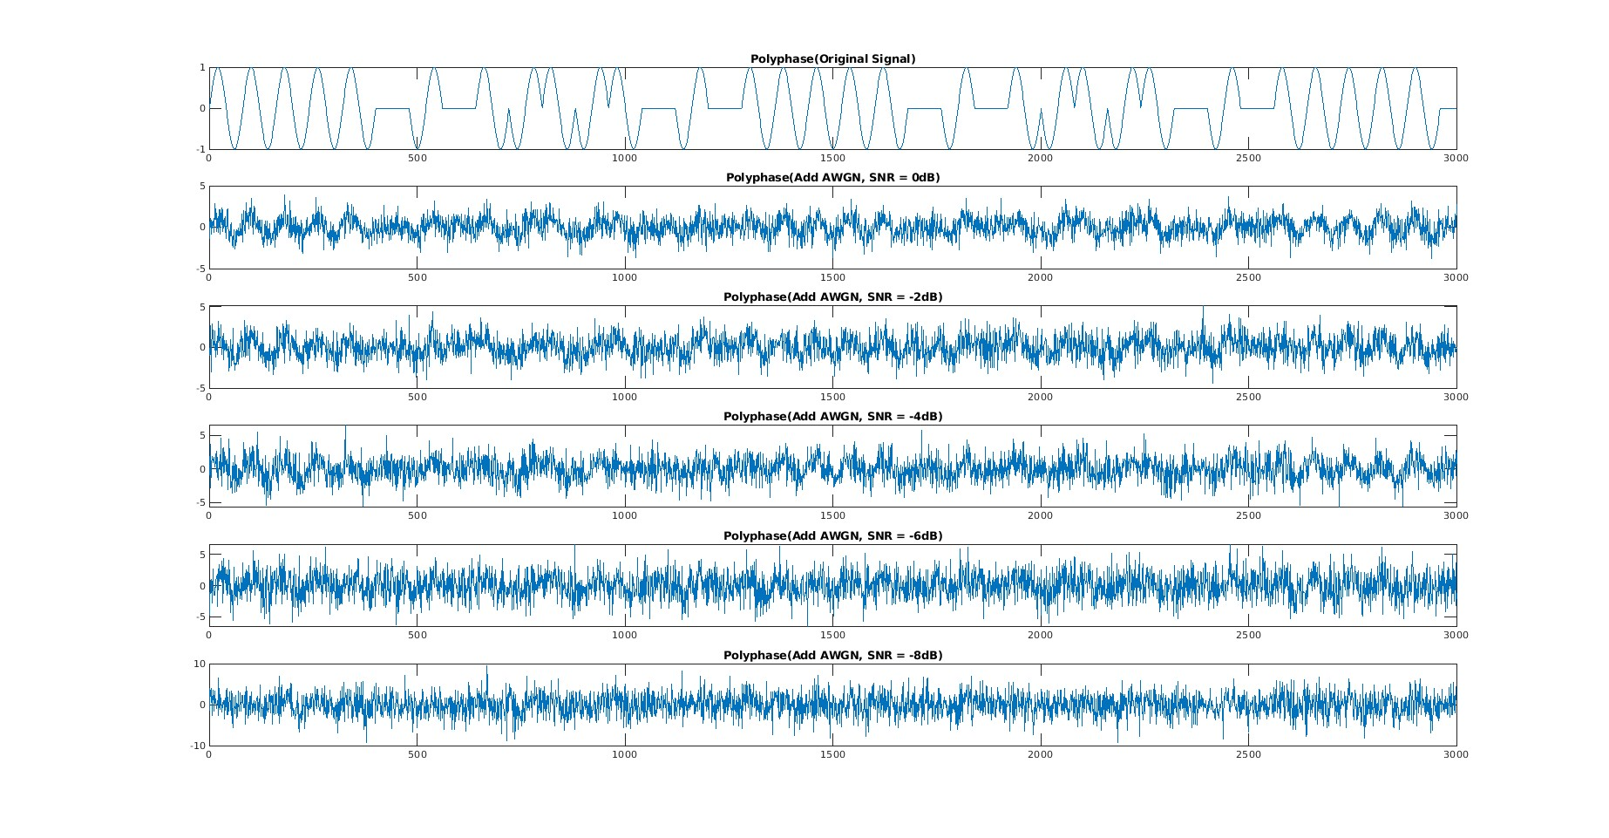
하계인턴7주차
18.
Polyphase : Sampling Rate / Sampling Frequency = 80

Slide 20
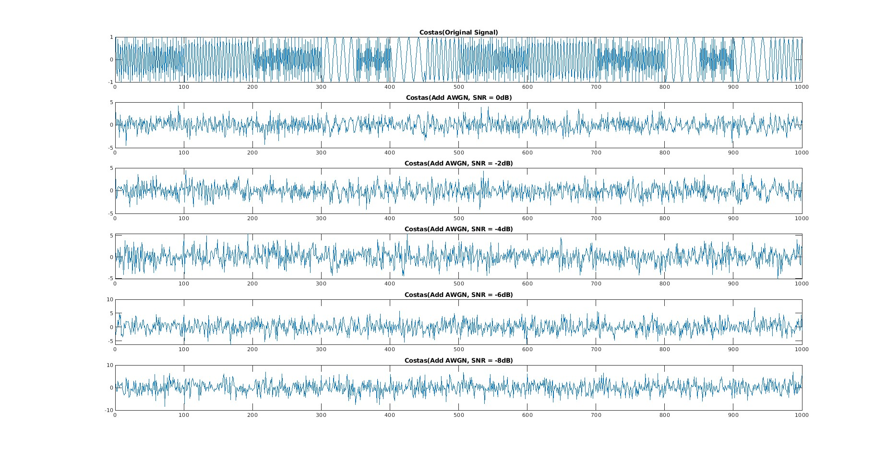
하계인턴7주차
19.
Costas : Interpolation = 50

Slide 21
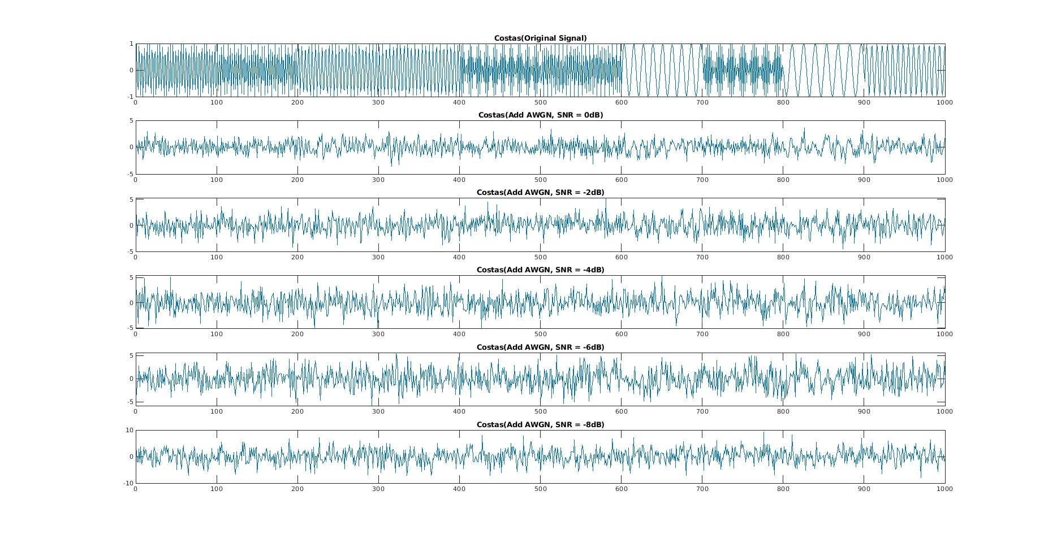
하계인턴7주차
20.
Costas : Interpolation = 100

Slide 22
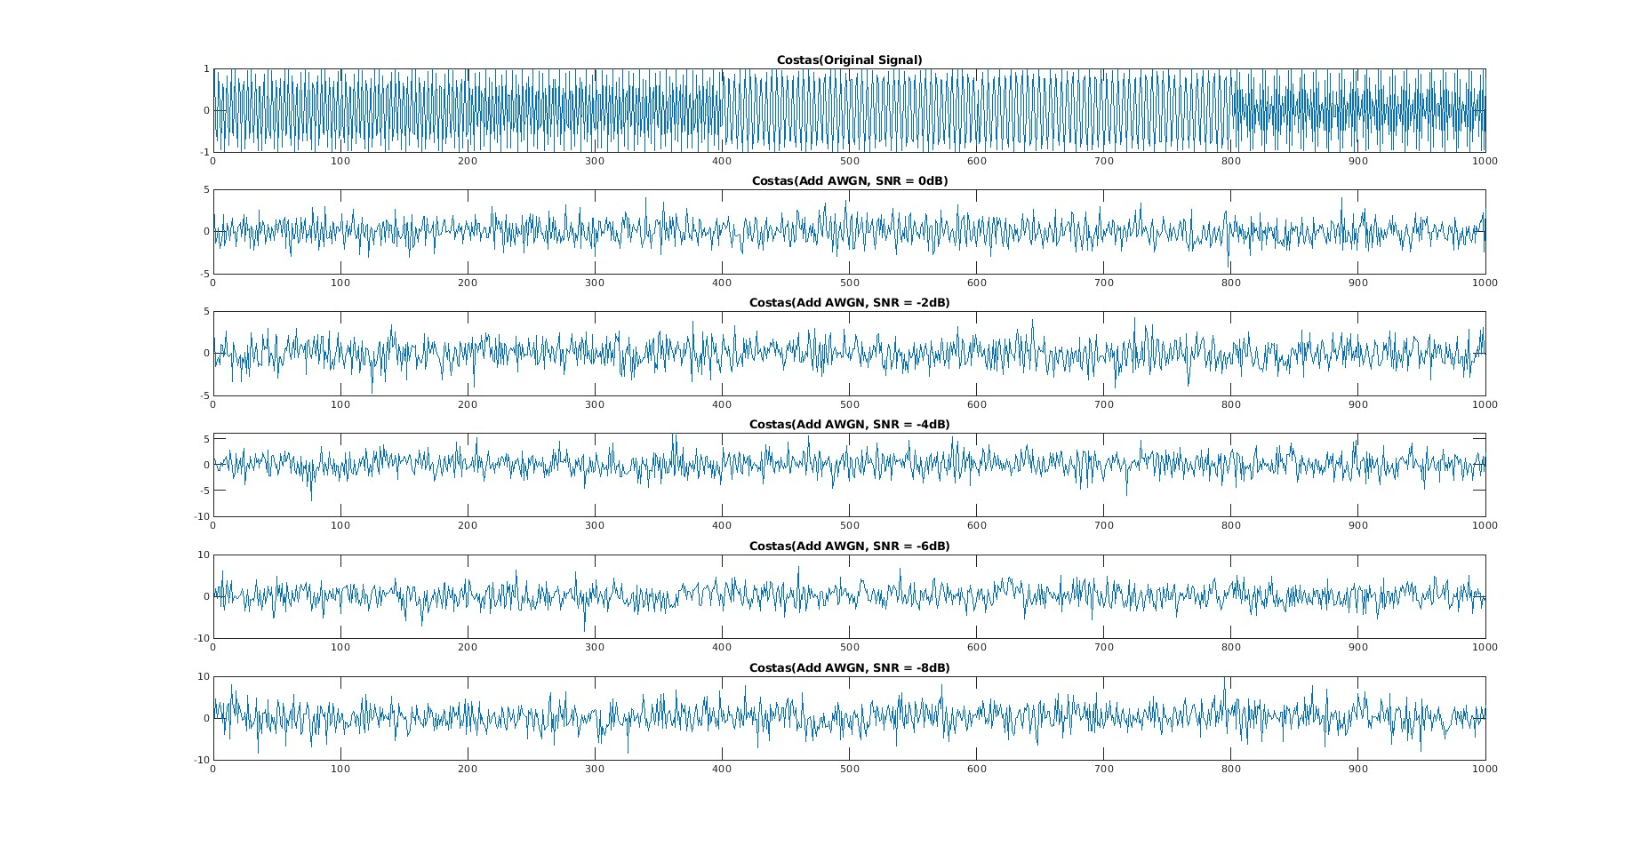
하계인턴7주차
21.
Costas : Interpolation = 200

Slide 23
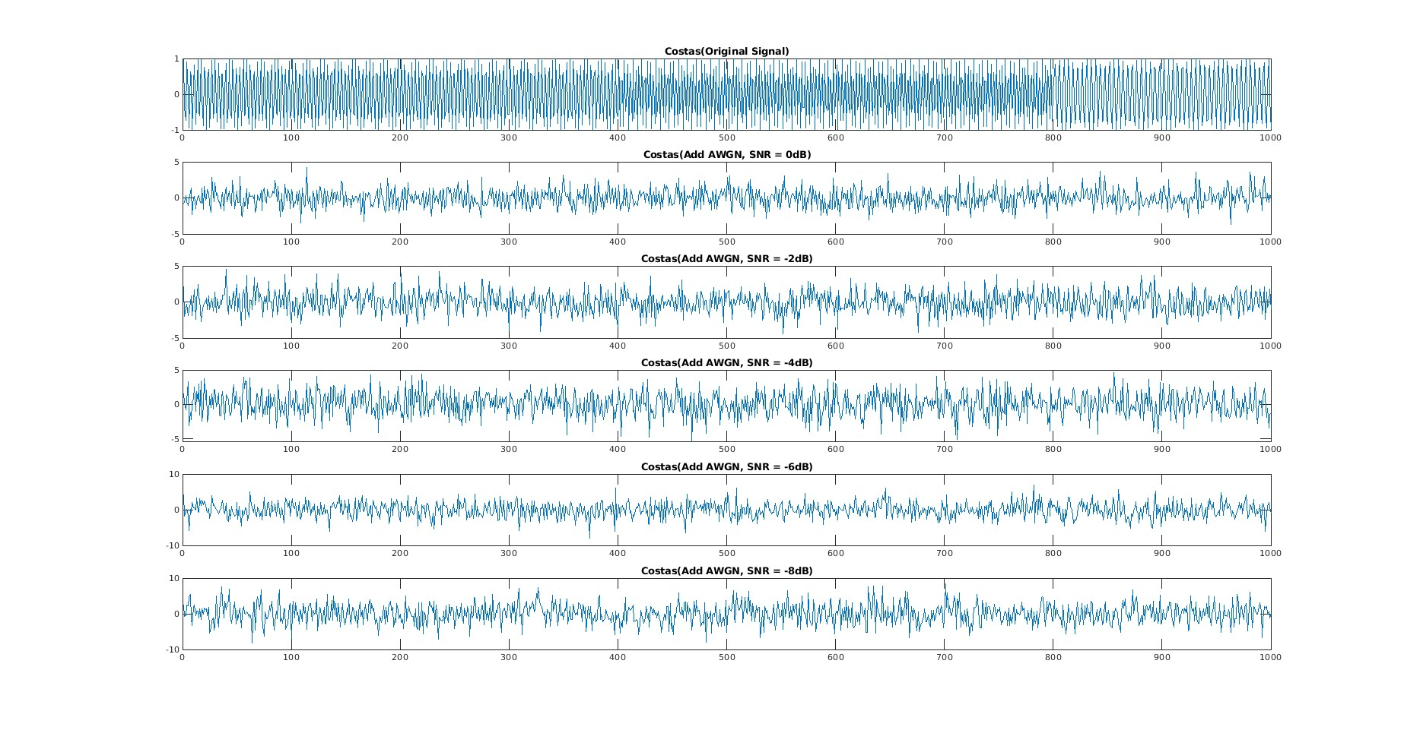
하계인턴7주차
22.
Costas : Interpolation = 400

